Slide 1
Digital Portfolio
STUDENT NAME: I ArunKumar
REGISTER NO AND NMID: autunm1667saz241667404
DEPARTMENT: BCA(COMPUTER APPLICATION)
COLLEGE: PONNUSAMY NADAR COLLEGE OF ARTS & SCIENCE
UNIVERSITY:UNIVERSITY OF MADRAS

Slide 2
PROJECT TITLE
Personal Portfolio Website

Slide 3


AGENDA
Project Overview
Problem Statement
End Users
Tools and Technologies
Portfolio design and Layout
Features and Functionality
Results and Screenshots
Conclusion
Github Link
3/21/2024 Annual Review

Slide 4

PROBLEM STATEMENT
Many students lack a professional platform to present their skills.
Resumes alone don’t effectively showcase creativity and projects.
Need for a personal portfolio website to highlight achievements and talents.

Slide 5

PROJECT OVERVIEW
Purpose: To showcase personal details, skills, and projects in a professional online format.
Goal: Create a simple, responsive, and user-friendly portfolio.
Title: Personal Portfolio Website

Slide 6

WHO ARE THE END USERS?
Students – showcase academic work and projects.
Job Recruiters – evaluate candidates’ skills and portfolios.
General Visitors – learn more about the individual.

Slide 7

TOOLS AND TECHNIQUES
HTML5 – structure
CSS3 – styling & layout
JavaScript – interactivity
Boxicons – icons
GitHub – version control & hosting

Slide 8
POTFOLIO DESIGN AND LAYOUT
Sections: Home, About Me, Contact
Responsive layout for desktop & mobile
Clean and modern design
Simple navigation menu
8

Slide 9
FEATURES AND FUNCTIONALITY
Interactive navigation bar
Personal introduction & about section
Contact form for communication
Footer with social media links
Responsive & mobile-friendly design

Slide 10
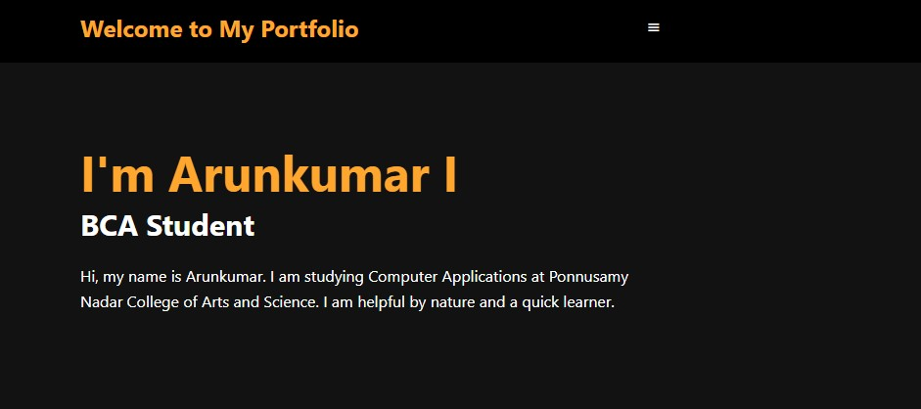

RESULTS AND SCREENSHOTS
3/21/2024 Annual Review
10

Slide 11
CONCLUSION
Successfully developed a personal portfolio website.
Easy to use, visually appealing, and informative.
Helpful for academic and professional growth.
11

